Slide 1


powered by Paza-Anulare
C
V
M
We save you from ordinality

Slide 2


Table of contents
Chapter One
Problem definition.......................................3
Chapter Two
Idea and solution approach......................12
Chapter Three
Technical solution description.................18
Chapter Four
The ultimate. Demo.......................20
Chapter Five
The team..........................................21

Slide 3

Chapter 1
PROBLEM DEFINITION

Slide 4

Interact

Slide 5
Present
Interact

Slide 6
Present
Edit
Interact

Slide 7

Present
SOOO
HARD!!
Edit
Interact

Slide 8

Technical Issues

Slide 9
Technical Issues
Misunderstanding

Slide 10
Nervousness
Technical Issues
Misunderstanding

Slide 11
Nervousness
Technical Issues
Lack of concentration
Misunderstanding

Slide 12

Solution??
MAYBE

Slide 13

IDEA
and
SOLUTION
APPROACH
Chapter 2

Slide 14

Pleasant user experience

Slide 15
Pleasant user experience
Digitalization

Slide 16
Efficacity
Pleasant user experience
Digitalization

Slide 17


COMPUTER
VISION
SOLUTION

Slide 18

Chapter 3
TECHNICAL SOLUTION DESCRIPTION

Slide 19


Solution architecture
Desktop App
Sign In
Log In
Files
Profile
Rooms
Add a new presentation
Profile Information
Meeting Settings
Create room
Join room
Collaborators
Turn On/Off features
Presentation
Search for collaborators
Join Meeting
Record Presentation

Slide 20

DEMO
Chapter 4

Slide 21

THE TEAM
Chapter 5

Slide 22


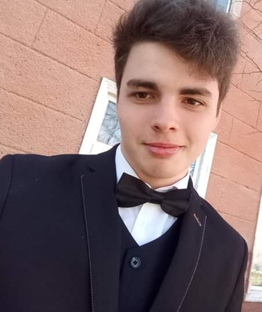
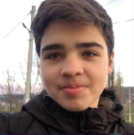






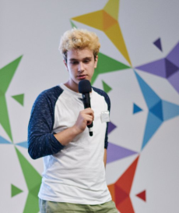


The Team
Perebinos Daniel
Balamatiuc Eduard
Graur Elena
Pulbere Vlada
Gherman Nicolae
Mentor
Moglan Mihai

Slide 23

Q&A

